Slide 1
Welcome to the experiment.
In this experiment, you will be shown word pairs in the center of the screen for several seconds each. One word will be shown in lowercase letters, the other in capital letters. You will need to remember the word in capital letters for a later memory test.
Use the word in lowercase letters (the “context” word) as an aid to remember to word given in capital letters (the “target” word). In other words, when you attempt to commit each target word to memory, think of the target word as it relates to the context word.
When you are ready, the experimenter will show you some example trials.

Slide 2
Example Trial
bee (context)
KNEE (target)

Slide 3
Example Trial
flag (context)
POLE (target)

Slide 4
Instructions, continued
Once again, try to remember the target word (the word in capital letters). To help with this, think about how the target word relates to the context word (the word on top).
If you have any questions, please ask them now. When you are ready, the experiment will begin.

Slide 5
Ready...

Slide 6
plane
CLOUD

Slide 7
computer
SCREEN

Slide 8
jut
RUT

Slide 9
stereo
PIONEER

Slide 10
house
MOUSE

Slide 11
thief
BEEF

Slide 12
music
DRUM

Slide 13
wall
BALL

Slide 14
insect
BUG

Slide 15
girl
BOY

Slide 16
pencil
PEN

Slide 17
wire
FIRE

Slide 18
fight
LIGHT

Slide 19
black
TACK

Slide 20
arm
LEG

Slide 21
night
DAY

Slide 22
boat
SHIP

Slide 23
hand
SAND

Slide 24
stars
MOON

Slide 25
weapon
KNIFE

Slide 26
meet
STREET

Slide 27
king
RING

Slide 28
hat
CAT

Slide 29
stream
RIVER

Slide 30
grass
GREEN

Slide 31
cop
MOP

Slide 32
metal
STEEL

Slide 33
tank
BANK

Slide 34
taxi
CAB

Slide 35
needle
THREAD

Slide 36
army
NAVY

Slide 37
gun
SUN

Slide 38
nail
PAIL

Slide 39
bird
ROBIN

Slide 40
luck
DUCK

Slide 41
book
MARK

Slide 42
white
KITE

Slide 43
shoe
LACE

Slide 44
cane
RAIN

Slide 45
scissors
PAPER

Slide 46
steam
TEAM

Slide 47
rock
SOCK

Slide 48
bear
HAIR

Slide 49
drink
BEER

Slide 50
ground
HOG

Slide 51
bar
CAR

Slide 52
flower
ROSE

Slide 53
feed
SEED

Slide 54
lake
SNAKE

Slide 55
ground
SOIL

Slide 56
apple
TREE

Slide 57
rope
SOAP

Slide 58
coin
DIME

Slide 59
nickel
PICKLE

Slide 60
patio
FURNITURE

Slide 61
saddle
PADDLE

Slide 62
Memory Test
Get out a piece of paper and number it from 1 to 48.
You will now receive a memory test for the target words (the words shown in capital letters). A series of memory cues will be presented on the screen for several seconds each. Use each memory cue as an aid for recalling a target word that was shown previously. Write the word on your paper as you go along. If you can’t remember the word that goes with the cue, place a dash on your paper in the corresponding line.
If you have any questions, please ask them now. When you are ready, the memory test will begin.

Slide 63
1
rhymes with house

Slide 64
2
associated with cattle

Slide 65
3
associated with music

Slide 66
4
rhymes with wall

Slide 67
5
rhymes with lug

Slide 68
6
rhymes with soy

Slide 69
7
associated with pencil

Slide 70
8
associated with wood

Slide 71
9
rhymes with fight

Slide 72
10
associated with board

Slide 73
11
associated with arm

Slide 74
12
rhymes with pay

Slide 75
13
rhymes with tip

Slide 76
14
rhymes with hand

Slide 77
15
associated with stars

Slide 78
16
associated with weapon

Slide 79
17
rhymes with meet

Slide 80
18
associated with finger

Slide 81
19
associated with dog

Slide 82
20
associated with stream

Slide 83
21
rhymes with spleen

Slide 84
22
rhymes with cop

Slide 85
23
associated with metal

Slide 86
24
associated with money

Slide 87
25
rhymes with lab

Slide 88
26
rhymes with fed

Slide 89
27
associated with army

Slide 90
28
rhymes with gun

Slide 91
29
associated with water

Slide 92
30
associated with bird

Slide 93
31
rhymes with luck

Slide 94
32
rhymes with lark

Slide 95
33
associated with sky

Slide 96
34
rhymes with case

Slide 97
35
rhymes with cane

Slide 98
36
associated with scissors

Slide 99
37
rhymes with steam

Slide 100
38
associated with foot

Slide 101
39
associated with head

Slide 102
40
associated with drink

Slide 103
41
rhymes with frog

Slide 104
42
associated with road

Slide 105
43
associated with flower

Slide 106
44
rhymes with feed

Slide 107
45
rhymes with lake

Slide 108
46
rhymes with bail

Slide 109
47
rhymes with tea

Slide 110
48
associated with bath

Slide 111
That’s the end of the experiment! Now let’s score the data...
Match the numbers below with the numbers on your answer sheet and count the number you recalled correctly. (Don’t worry about spelling errors.) Write your total in the blank labeled R-R.
1. mouse 28. sun
4. ball 31. duck
9. light 35. rain
14. sand 37. team
17. street 44. seed
22. mop 45. snake

Slide 112
Match the numbers below with the numbers on your answer sheet and count the number you recalled correctly. (Don’t worry about spelling errors.) Write your total in the blank labeled R-A.
2. beef 29. pail
8. fire 33. kite
10. tack 38. sock
18. ring 39. hair
19. cat 42. car
24. bank 48. soap

Slide 113
Match the numbers below with the numbers on your answer sheet and count the number you recalled correctly. (Don’t worry about spelling errors.) Write your total in the blank labeled A-R.
5. bug 26. thread
6. boy 32. mark
12. day 34. lace
13. ship 41. hog
21. green 46. soil
25. cab 47. tree

Slide 114
Match the numbers below with the numbers on your answer sheet and count the number you recalled correctly. (Don’t worry about spelling errors.) Write your total in the blank labeled A-A.
3. drum 23. steel
7. pen 27. navy
11. leg 30. robin
15. moon 36. paper
16. knife 40. beer
20. river 43. rose

Slide 115
Debrief
This experiment is a replication of Fisher and Craik (1977). It demonstrates something called the encoding specificity principle. It builds off Craik and Tulving’s (1975) levels of processing effect, in that it shows how we think about something affects encoding and later retrieval. However, unlike in the levels of processing effect, encoding specificity shows that “deeper” processing does not always lead to better retrieval.
There were four conditions in this experiment, involving the type of processing during study and the type of processing during test.

Slide 116
Conditions
STUDY
TEST
house MOUSE
music DRUM
thief BEEF
insect BUG
rhymes with house
associated with music
associated with cattle
rhymes with lug
Match (R-R)
Match (A-A)
Mismatch (R-A)
Mismatch (A-R)

Slide 117
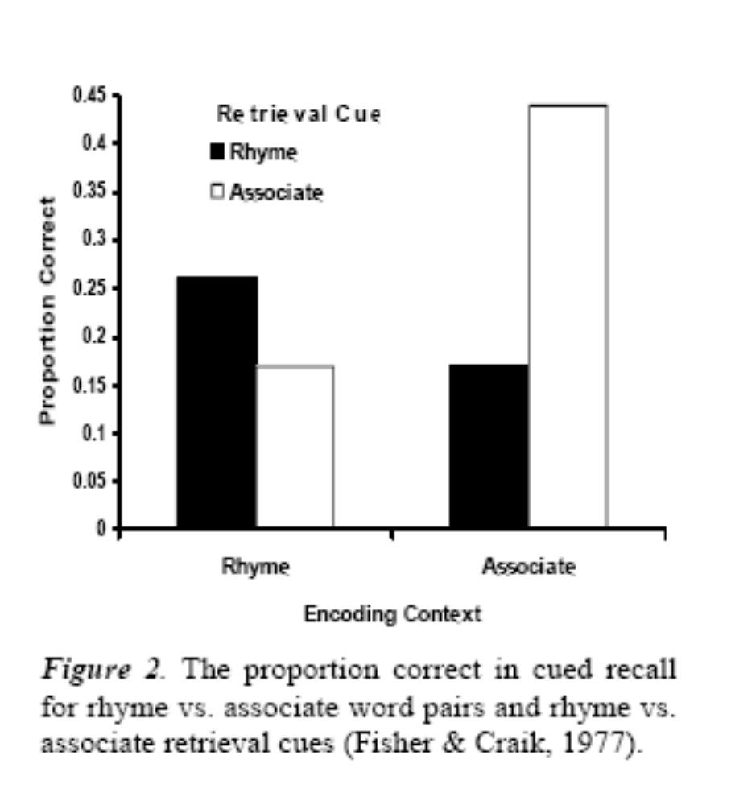
Debrief, continued
Typical results show that a match between processing at encoding and retrieval produces the best memory performance, even for more shallow levels of processing (such as rhymes). This is similar to other findings, such as context-dependent memory (Godden and Baddeley, 1975) and state-dependent memory (Goodwin et al., 1969).

